Slide 1
Current and New Applications of CLA+
Roger Benjamin
CAE
HEFCE Conference
London
February 9, 2015

Slide 2
Themes
Origin and evolution of the CLA Value Added protocol
Meeting new challenges: CLA+ Career Connect
Observations about adapting standardized assessments in the United Kingdom

Slide 3
History Matters, 1999-2004
Measurement scientists and education policy specialists at RAND launch new approach to standardized assessment in post-secondary education.
Goals and Premises of the group,
Focus on improvement
Maintain high measurement science standards
Gain initial funding from foundations

Slide 4
Purposes of CLA+
Measures critical thinking skills faculty/employers emphasize
Analysis and problem solving
Scientific and quantitative reasoning
Critical reading and evaluation
Critique and argument
Writing mechanics, writing effectiveness
Provides within and across institutional benchmarks for measuring improvement
Influences curriculum and instruction
Provides test results, normed and criterion referenced for individual students

Slide 5
CLA + 90 minute Test Features
Performance tasks, direct measures of critical-thinking, require open-ended, constructed responses
Selective Response Questions require critical thinking skills
The student and the school are the units of analysis
Control for input (ACT/SAT scores or other proxy)
Internet-based test for administration, scoring, and reporting
Computer assisted scoring
Use engaging cases and problems that assess an integrated combination of skills based on a variety of topics from arts and sciences. Document library provides all the information needed for the student.

Slide 6
Sample Performance Tasks
Lionfish Science
More memory Science
Life expectancy Science
Myth of Icarus Humanities
Museum Humanities
Literacy Organization Humanities
Lake-to-River Social sciences
Social media Social science
Crime reduction Public policy
Voting age Public policy

Slide 7
Case for Performance Assessment
Performance assessments predict college freshmen success as well as the SAT or ACT.
Performance assessments therefore become highly desirable because,
Such tests illustrate the desired coherence between instruction, assessment, and the complex challenges students face in the classroom and beyond.
They are superior to multiple choice tests that only predict success.
Class time spent on teaching students how to apply knowledge and skills to real-world problems is time well spent. Teach-to-test should therefore be encouraged for performance assessments which are based on real world problems or cases to analyze.

Slide 8
Is Critical Thinking Independent From Academic Disciplines?
Critical-thinking skills are situated between Spearman’s G---a single undifferentiated general intelligence and differing and independent kinds of intelligence (Gardner). Critical-thinking skills are broad abilities that are applicable across an array of academic disciplines or domains.

Slide 9
Are Interaction Effects With disciplines Inevitable? The Chemistry Flame Test
Students are evaluated on whether they can figure out the chemical composition of an unknown substance by its response to a flame test
But also on the appropriateness of the tests they ran, the sequence of those tests, and the rationale for their conclusions
This test requires substantive and procedural knowledge but it also assesses generic problem-solving and reasoning skills.

Slide 10
The Value Added Approach
Provides an estimate of a school’s contribution to student learning after controlling for input based on a matrix sampling design.
Involves computing whether a school’s mean CLA score is higher or lower than what would be expected given (a) its mean SAT/ACT score and (b) the typical relationship between mean CLA and SAT/ACT scores among all the schools in the program.
Facilitates measuring and interpreting the progress a school’s students made relative to students at similarly situated colleges.

Slide 11
Critics: Attrition and Motivation Effects Negates Value Added Growth Claims
Students’ entering academic ability (EAA) scores are made up of their SAT/ACT math and critical reading scores.
The difference in the EAA scores between freshmen and senior cohorts is 20 points, less than a 2% difference. This is not enough to explain a mean .73 effect size value added score (equating to 19% variance) across 1,400 institutions testing over 8 years.

Slide 12
Value Added Results for Colleges Testing 2009-12

Slide 13
The Case for Comparisons
Most colleges as well as faculty and employers commit to improving critical-thinking skills.
Without comparisons based on appropriate standardized tests, institutions (and countries) are isolated one from another with no basis to know how well they are doing.
International comparisons are challenging but appear to be promising.

Slide 14
Other Questions
Will CLA+ not create a teach-to-the-test environment?
Is not CLA+ reductive in nature just like other such tests?
How are the testing results used?

Slide 15
Where We Stand Today
Measurement science community (TVS study) agrees that critical thinking is real, important, can be improved, and can be measured in a reliable and valid way.
The Dep. of Education funded 21st century test program (2012) is leading to new assessment paradigms beyond multiple choice tests.
Computer-assisted scoring creates new assessment opportunities for performance-based assessment in the classroom.
Methodological innovations such as propensity matching analysis make international comparisons promising.

Slide 16
Strengthening the Value Added Approach
Many colleges find the value added approach useful for internal improvement and accountability, however, assessment not yet viewed as essential to post-secondary education,
Students are neither required to take the test or try hard on it if they do.
Professors do not have clear incentives to improve the critical-thinking skills of their students
Colleges are not asked to demonstrate they produce students with the critical-thinking skills employers say are requisites for work success.

Slide 17
The Solution
The value added no stakes focus on improvement needs to be integrated with a CLA+ test focused on a problem of sufficient stakes that is compelling to students, professors, employers and colleges.
If this step is accomplished, stronger incentives to focus on improvement of teaching and learning assisted by formative and standardized assessment will exist at all levels of post- secondary education.

Slide 18
The Problem To Focus On: College To Career
Two problems, combine, to warrant CLA+ focus with stakes attached,
The imperative to improve human capital, the principal resource any nation has, through the post-secondary system.
The need to provide equal opportunity for all college graduates to compete on a level playing field for jobs they are qualified for.

Slide 19
The Major Policy Challenge
A small set of selective colleges form a positional good that blunts the opportunities of too many high ability college seniors in less selective colleges to obtain high value added jobs.
The result is a mal-distribution of human capital at the national level and an unequal playing field for too many high ability students who graduate from less selective colleges.

Slide 20
A Market Failure in the Graduating Seniors to Career Space
They are impediments that impede the efficiency and effectiveness of buyer (employer) and seller (graduating college senior) exchanges.
In this case,
Because of grade inflation, the cumulative national mean senior GPA is 3.3 on a 4.0 scale.
Employers do not have the information they need to decide which applicants to interview. Too many students do not get a chance to interview with appropriate potential employers. Colleges do not know which skills employers are looking for or what skills they should inform employers they should evaluate.

Slide 21
Table 1

Slide 22
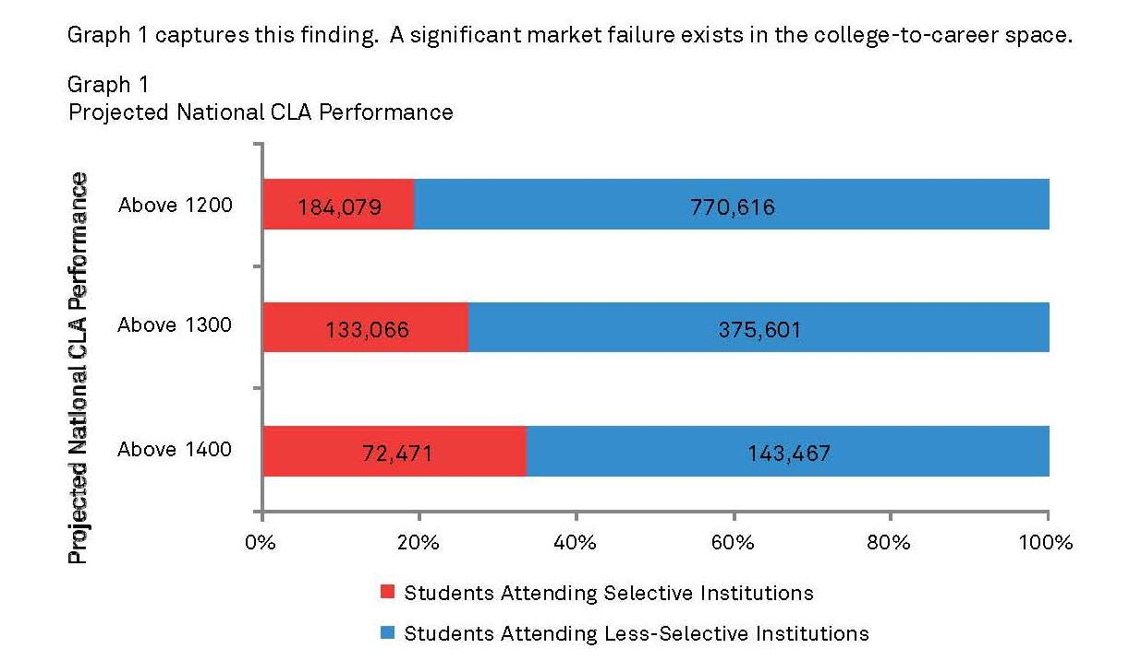
Graph 1 Projected National CLA+ Performance

Slide 23
Geographic Distribution of Institutions, by Selectivity

Slide 24
Selective Colleges Are Isolated From Most Students
The 143 selective colleges, largely in the North East, form a positional good gatekeeper system that overly determines the life chances of all college graduates in the United States.
The location of the selective colleges means there is a geographic disconnect with large and growing ethnic/racial groups throughout the United States.

Slide 25
Work Readiness Assessments
Are focused on Human Resource office requirements and are comprised of one or more of the following,
Personality measures, e g., extrovert/introvert, degree of teamwork, persistence, well being
Academic discipline tests, Content/knowledge
Aptitude tests, prediction of ability of candidate to succeed in specific fields---Work Keys
Ability tests, “hard and soft” cognitive measures

Slide 26
Evaluation of Work Readiness Tests Suggests Significant Problems
The criteria to evaluate assessments are reliability, validity, time, and cost.
There is no consensus about ability of work readiness tests, alone or in combination, to meet the evaluation criteria.
Moreover, work readiness tests do not deal directly with the market failure issue.

Slide 27
The CLA+ Career Connect Premise
Career connect is designed as a pre-screening tool between college and career, upstream from Human Resource offices. This is the major part of the market failure problem.
Department of Labor OBON data base demonstrates hundreds of fields require critical thinking skills measured by CLA+.
The CLA+ and its career connect system meets Occam’s Razor requirements---metrics should deal with the most significant problem and not be multiplied unnecessarily to cover it.
Therefore, offer CLA+ Career Connect to graduating seniors
Use Career Connect system to bring employers and students together

Slide 28
What Is The CLA+ Career Connect System?
Badges for students who take CLA+ and score in top 50%---proficient, accomplished, advanced. Students can take CLA+ through their institutions or alone.
Qualifying students will be able share CLA+ scores directly on employment boards.
Virtual career fair that brings employers and badged students together . Employers chose students they wish to continue the potential employment process with.

Slide 29
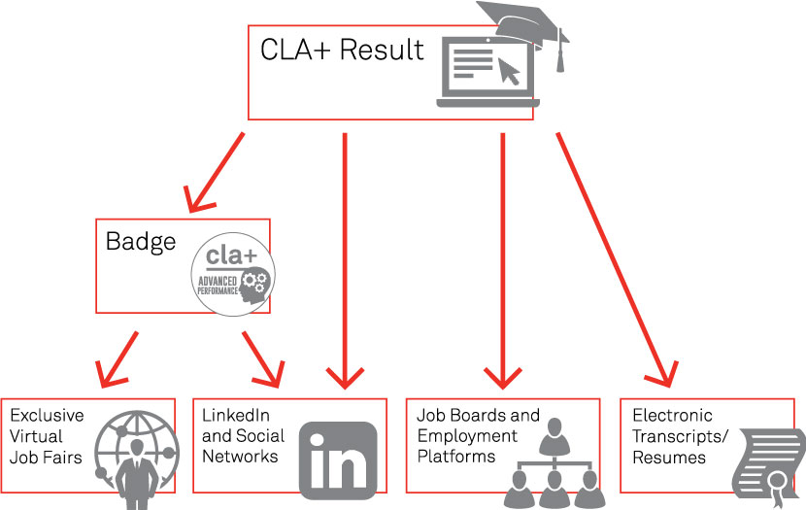
CLA+ Career Connect

Slide 30
Applications of CLA+ Career Connect
National U.S. Pilot May 2014 results,
Eight percent of the 20,000 testing seniors scored in the advanced levels
Employer Fortune 500 group found 20 percent of members of this group who attended a virtual career fair acceptable to hire and indicated they would participate in Career Connect again
Two regional applications underway in Texas
Italian Teco (CLA+) with Career Connect underway for this spring

Slide 31
Implications
In U.S. current positional good-based system led by selective colleges (founded before 1900) in U.S. is no longer sustainable. The population has grown from 75 million in 1900 to over 320 million in 2014 and will increase to over 400 million over the next several decades.
Countries in the European Union and elsewhere may face similar market failures with different characteristics.

Slide 32
Three Factors Create Need For Standardized Assessments
Recognition of the centrality of human capital will translate into more demands for oversight
The “cost-disease” problem, combined with declining public resources, presents the need for metrics to evaluate quality of outcomes.
The drive for equal opportunity will accelerate the use of objective measures of student learning outcomes graduating seniors can use.

Slide 33
The Principal Goal
Is to make assessment, formative and standardized, essential to teaching and learning.
When this is accomplished, we will have taken a significant step toward a continuous system of improvement of undergraduate education analogous to the peer review based continuous system of improvement that drives research.

Slide 34
Challenges of Adapting U.S.-Based Standardized Assessments to UK
Translation and adaptation of assessment items required if international comparisons desired.
Value added approach possible but A Levels provide different starting point and typical undergraduate program is three not four years. Equating, standard setting methods useful.
For value added approach no tests like SAT to use to adjust for entering abilities? Propensity matching analysis is a possibility.

Slide 35
References
See R. Benjamin et al., (2013), The Case for Critical Thinking Skills and Performance Assessment at cae.org for review of reliability and validity studies of CLA.
For sample performance tasks and selective response tests see http://cae.org/images/uploads/pdf/CLA_Plus_Practice_PT.pdf and http://cae.org/images/uploads/pdf/CLA_Student_Guide_Institution.pdf

